Slide 1
Grade 8: Alignment to Mathematics
Grade-Level Standards
Notes:
This module was last updated on January 2017.
Over the past several years, we have seen several changes in states K-12 assessment systems as states work (sometimes collaboratively) to design assessment systems that provide information on students’ progress toward college and career readiness in mathematics and English language arts. For many states, this was a major change from previous assessments, which were largely characterized by multiple-choice items that were not reflective of the comprehensive set of skills defined by college-and-career ready standards.
The goal of this module is to provide guidance on grade 8 item development and alignment, highlighting the Council of Chief State School Officers Criteria for High-Quality Assessments and the collective experiences of the assessment consortia and individual states throughout their multi-year assessment design processes.

Slide 2
Session Objective
The purpose of these materials is to help develop understanding of the expectations of high-quality summative assessment items. The concepts shown throughout these modules can be useful for classroom questioning and assessment, but the items themselves may need to be slightly modified.

Slide 3
CCSSO Section C: Align to Standards – Mathematics
Criterion C.1: Focusing strongly on the content most
needed for success in later
mathematics
Criterion C.2: Assessing a balance of concepts, procedures, and applications
Criterion C.3: Connecting practice to content
Criterion C.4: Requiring a range of cognitive demand
Criterion C.5: Ensuring high-quality items and a
variety of item types
Notes:
Based on the need to provide guidance for what high-quality assessments looked like, the Council of Chief State School Officers created the Criteria for Procuring and Evaluating High-Quality Assessments. More information on this document can be found in the “Test Level Considerations” presentation for Mathematics. The full document is also available online. http://ccsso.org/News_and_Events/Press_Releases/State_Chiefs_Release_Criteria_for_High-Quality_Assessment.html
In 2013, CCSSO worked with their stakeholders, the Chief State School Officers, to draft principles of high-quality assessments. These principles described the characteristics of high-quality assessments aligned to college and career readiness. Through the end of 2013 and into 2014, CCSSO continued working with their stakeholders to clarify what these principles mean. The principles became criteria with metrics used to judge whether these principles were realized in assessment systems. These are the criteria on which this review of assessment systems will be based.
There are six sections of the CCSSO Criteria. Overarching goals and technical quality (e.g., accessibility, validity, and reliability) come first. Then two sections on content alignment. Then reports, administration, and a section where states can add criteria reflecting individual state needs. The overall document is designed to be “drop in” for a state’s RFP and can be modified as needed. It could also could serve as a “drop in” checklist of criteria for evaluating an existing assessment. For the purpose of this module, we will focus on Section C: Align to Standards – Mathematics. The slide shows the five content alignment criteria in Section C of the CCSSO document, which is the section covering mathematics.
College and career readiness has specific implications for math content, math instruction, and therefore, math assessment. We are not talking about just *any* mathematics, by the way, but mathematics that aims at college and career readiness. States require assessments that match the depth, breadth, and rigor of the standards, accurately measure student progress towards college and career readiness, and provide valid data to inform teaching and learning.

Slide 4
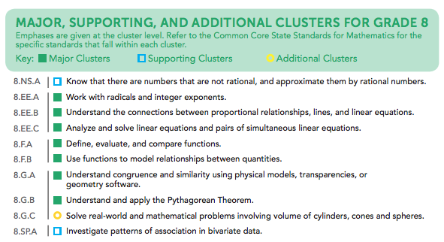
Notes:
Criteria 1 emphasizes the content most needed for success in later mathematics. Throughout this presentation, this will be referred to as “major work of the grade” or just “major work.” This table shows the grade 8 content clusters classified as Major, Supporting, and Additional.
Major Clusters coherently capture the emphases at each grade; Supporting Clusters have natural connections to Major Clusters; and Additional Clusters stand well on their own, with weaker natural connections to the Major Clusters. PARCC, Smarter Balanced, and several states working independently on developing aligned assessments used these designations to inform the proportional representation of content reflected in their summative test blueprints.
It is also worth pointing out that the structure of the standards organized by domain, then by cluster, reveal things that are different in these standards than states’ previous standards. For example, there has never been a standards document before that uses Ratios and Proportional Relationships as a top-level organizer; the fact that CCSS uses it as a top-level organizer signals its emphasis in the document. In general, standards that are college and career ready based on evidence will drive towards a substantial amount of algebra for all students during middle school. The major work designations trace that trajectory.

Slide 5
Ten Principles of CCSS-Aligned Items
1. Most items aligned to standards in supporting clusters connect to the major work of the grade.
2. Items are designed to address the aspect(s) of rigor (conceptual understanding, procedural skill, and application) evident in the language of the content standards.
3. Items are designed to attend to content limits articulated in the standards.
4. Most items aligned to a single content standard should assess the central concern of the standard.
5. Representations are well suited to the mathematics that students are learning and serve an important purpose within the item itself.
6. Items use mathematically precise language, are free from mathematical errors or ambiguities, and are aligned to the mathematically appropriate standard.
7. The demands of items measuring the Standards for Mathematical Practice are appropriate to the targeted grade level.
8. Item types are chosen to match the item’s purpose and as part of the evidence required by the standards.
9. Most items measuring the Standards for Mathematical Practice are also aligned to content standards representing the major work of the grade.
10. Items written at the cluster or domain level measure key integration points not necessarily articulated in individual standards but plausibly implied directly by what is written.
Notes:
Here are ten principles that can be used to guide the creation of CCSS-aligned assessment items. This list was generated based on common issues identified by the assessment consortia as well as individual states as they worked to develop next-generation assessment systems. You will also note connections back to the CCSSO criteria. For example, alignment principles 1 and 9 are used to support Criterion 1, focusing strongly on the content needed for success in later mathematics. Note that these two also use the phrase “major work of the grade” as defined in the previous slide. As another example, Principle 2 is directly tied to Criterion 2, assessing a balance of concepts, procedures, and applications.
Each principle will be illustrated through examples selected from publicly available sources or created by Student Achievement Partners content staff.

Slide 6

Alignment Principle #1
Most items aligned to standards in supporting
clusters connect to the major work of the grade.
Notes:
The word “supporting” that is used to describe a subset of the K-8 Common Core State Standards for Mathematics signals that these standards are well connected to the content representing the major work of the grade. Many of the standards in the Measurement & Data domain, for example, require students to solve problems based on the grade-level work in the Operations & Algebraic Thinking and the Number & Operations – Fractions domains. These connections reinforce the important work in grades K-8, allowing students to engage deeply with the content instead of seeing mathematics as a set of discrete topics.

Slide 7
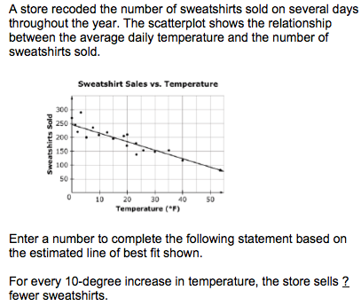
Most items aligned to standards in supporting clusters connect to the major work of the grade.
8.SP.A.3 Use the equation of a linear model to solve problems in the context of bivariate measurement data, interpreting the slope and intercept.
Notes:
Let’s look at this example item written to illustrate Alignment Principle 1.
Answer key: Answer within an acceptable range (i.e., 25-40)
What makes this item a good illustration of Alignment Principle 1?
The primary standards alignment for this item is to 8.SP.A.3. As a supporting cluster in the SP domain, assessment items should be designed to connect to the work in the functions domain where students are modeling relationships between quantities and interpreting slopes and intercepts. This particular item also connects nicely to the content of 8.EE.B, asking for the change in the number of sweatshirts with respect to a 10-degree change in temperature. Since it isn’t a direct interpretation of the slope, it reinforces the understanding in 8.EE.B.6 that the slope m is the same between any two distinct points on a non-vertical line in the coordinate plane.

Slide 8

Alignment Principle #2
Items are designed to address the aspect(s) of rigor (conceptual understanding, procedural skill, and application) evident in the language of the content standards.
Notes:
The language used in the standards provides information about which aspects of rigor should be targeted in items written for those standards. Words and phrases like “extend previous understandings,” “fluently multiply,” and “solve” signal a need for items that measure conceptual understanding, procedural skill, and application, respectively. The following slides provide examples of grade 8 items, the standards to which they are written, and the key words signaling the aspects of rigor.

Slide 9
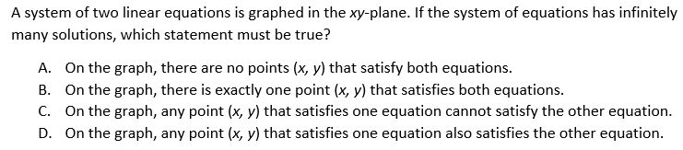
Items are designed to address the aspect(s) of rigor (conceptual understanding, procedural skill, and application) evident in the language of the content standards.
8.EE.C.8a. Understand that solutions to a system of two linear equations in two variables correspond to points of intersection of their graphs, because points of intersection satisfy both equations simultaneously.
Notes:
© Item adapted from the PARCC Grade 8 EOY Test. Available from https://prc.parcconline.org/assessments/parcc-released-items; accessed April 2016.
Let’s look at this example item written to illustrate Alignment Principle 2.
Answer key: D
What makes this item a good illustration of Alignment Principle 2?
Grade 8 work with systems of equations in two variables requires not only that students are able to solve systems, but that they understand the meaning of the solutions. This item targets standard 8.EE.C.8a, which is the conceptual understanding of the solutions to a system of equations in two variables.

Slide 10

Items are designed to address the aspect(s) of rigor (conceptual understanding, procedural skill, and application) evident in the language of the content standards.
8.NS.A.1. Know that numbers that are not rational are called irrational. Understand informally that every number has a decimal expansion; for rational numbers show that the decimal expansion repeats eventually, and convert a decimal expansion which repeats eventually into a rational number.
Notes:
© Item retrieved from the PARCC Grade 8 EOY Test. Available from https://prc.parcconline.org/assessments/parcc-released-items; accessed April 2016.
Let’s look at this example item written to illustrate Alignment Principle 2.
Answer key: 4/9
What makes this item a good illustration of Alignment Principle 2?
This standard has both conceptual and procedural components. This item is specifically targeting the straightforward procedural part of the standard highlighted in green.

Slide 11
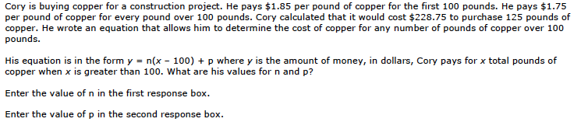
Items are designed to address the aspect(s) of rigor (conceptual understanding, procedural skill, and application) evident in the language of the content standards.
8.F.B Use functions to model relationships between quantities.
Notes:
© Item retrieved from the Smarter Balanced Grade 8 Claim 4 Item Specifications. Available from http://www.smarterbalanced.org/assessments/; accessed April 2016.
Let’s look at this example item written to illustrate Alignment Principle 2.
Answer key: n=1.75; p=185
What makes this item a good illustration of Alignment Principle 2?
In grade 8, students use functions to model relationships between quantities, which makes this cluster (8.F.B) one that has a primary focus on application problems. This item targets the application aspect of rigor asking students to carefully consider the definition of the variables given and how they relate to the other quantities defined by the problem.

Slide 12
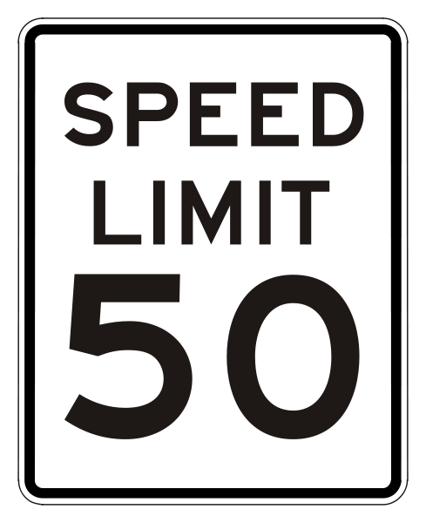


Alignment Principle #3
Items are designed to attend to content limits articulated in the standards.
Notes:
Content limits are often established at the grade level, so it is essential that item writers know and understand the content standards for the entire grade level, not just a single standard for which they may be authoring items. Operations & Algebraic Thinking, Number & Operations in Base Ten, and Number & Operations – Fractions domains all have specific content limits that must be attended to even in items where the direct target of measurement is in a different domain. For example, if students are solving two-step word problems using the four operations in grade 3, and one of the steps happens to be addition, it is important to pay attention to the ceiling established in NBT for addition even though the item will be aligned to the standard in OA.

Slide 13
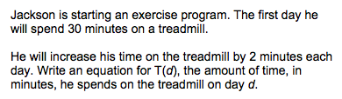
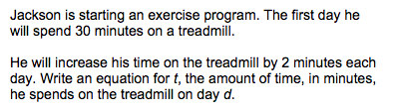
Items are designed to attend to content limits articulated in the standards.
8.F.B.4 Construct a function to model a linear relationship between two quantities. Determine the rate of change and initial value of the function from a description of a relationship or from two (x, y) values, including reading these from a table or from a graph. Interpret the rate of change and initial value of a linear function in terms of the situation it models, and in terms of its graph or a table of values.
Notes:
Let’s look at this example item written to illustrate Alignment Principle 3.
Answer key: T(d)=30+2(d-1); t=30+2(d-1)
What makes this item a good illustration of Alignment Principle 3?
A footnote in the grade 8 standards reads “¹Function notation is not required in Grade 8.” Assessment developers should be sensitive to this footnote and avoid using items that require students to use or understand function notation.

Slide 14

Alignment Principle #4
Most items aligned to a single content standard should assess the central concern of the standard.
Notes:
Covering the “breadth” of a standard has often meant attending to every noun, verb, and strategy articulated in the standard and breaking it down into very fine-grained, measurable outcomes. So it is common for item authors to look at the “e.g.” portion of the standard and write items that measure each example given. Often these examples illustrate strategies that are useful as part of teaching and learning to help students become mathematically proficient. Items should be designed in such a way that make certain strategies more efficient and/or appealing when such strategies are articulated. However, summative assessments are designed to measure what students have learned and less how they learned it; therefore, we want the items to measure the core desired outcome of the standard, not merely emphasize the choice of strategy.

Slide 15
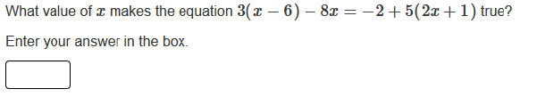

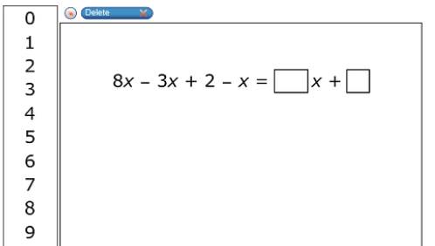
Most items aligned to a single content standard should assess the central concern of the standard.
Central Concern
Not the Central Concern
8.EE.C.7. Solve linear equations in one variable.
Notes:
© Item retrieved from the PARCC Grade 8 EOY Test. Available from https://prc.parcconline.org/assessments/parcc-released-items; accessed April 2016.
© Item retrieved from the Smarter Balanced 2015 Grade 8 Practice Test. Available from http://www.smarterbalanced.org/assessments/; accessed April 2016.
Let’s look at this example item written to illustrate Alignment Principle 4.
Answer key: -1.4; 4, number not equal to 2
What makes this item a good illustration of Alignment Principle 4?
Note that these two items come from different sub-standards within 8.EE.C.7, the first aligning directly to 8.EE.C.7b and the second to 8.EE.C.7a. Both items are well aligned to the direct target of those sub-standards under 8.EE.C.7, so here we intend to emphasize how item authors should use the structure of the standards as a signal about what the “central concern” is. We list the overarching 8.EE.C.7 here which is “Solve linear equations in one variable” as a way of pointing out that students in grade 8 should see a variety of items from 8.EE.C.7b and a more limited number from 8.EE.C.7a to fully realize the goal articulated in the higher order structure of the standards.
[For reference, the language of those standards:
a. Give examples of linear equations in one variable with one solution, infinitely many solutions, or no solutions. Show which of these possibilities is the case by successively transforming the given equation into simpler forms, until an equivalent equation of the form x = a, a = a, or a = b results (where a and b are different numbers).
b. Solve linear equations with rational number coefficients, including equations whose solutions require expanding expressions using the distributive property and collecting like terms. ]
The central concern principle generally has little to do with quality of items and is more intended to provide direction about quantity to ensure that critical emphases within the standards are well represented in item pools and/or individual student test forms.

Slide 16

Alignment Principle #5
Representations are well suited to the mathematics that students are learning and serve an important purpose within the item itself.
Notes:
Representations, such as number lines and area models, should be well connected to the mathematics that students are learning and serve an important purpose within the item itself.
When developing an item an item writer should ask: “Is there something mathematically important about including this representation?” If the answer is “Yes,” then the item writer should proceed. The next question the item writer must ask when developing an item should be: “Is the representation giving the appearance of a particular solution path even though other strategies are viable and likely?” The answer to this question should be “No.” Answering these questions will help an item writer decide whether to include a particular representation.

Slide 17
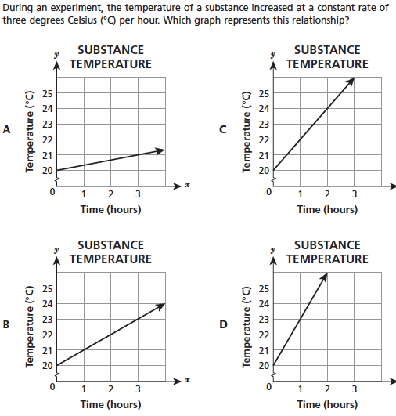
Representations are well suited to the mathematics that students are learning and serve an important purpose within the item itself.
8.EE.B Understand the connections between proportional relationships, lines, and linear equations.
Notes:
© Item retrieved from EngageNY.org of the New York State Education Department. 2015 Grade 8 Mathematics Test Released Questions. Internet. Available from https://www.engageny.org/resource/released-2015-3-8-ela-and-mathematics-state-test-questions; accessed April 15, 2016.
Let’s look at this example item written to illustrate Alignment Principle 5.
Answer key: D
What makes this item a good illustration of Alignment Principle 5?
In grade 8, students expand on their grade 7 work with proportional relationships to begin to work with graphs that do not go through the origin and to interpret the slope and intercept of such lines. Graphical representations play an important role in this progression, allowing students to connect familiar forms of an equation, like y=mx+b, to the features of the graph and to the relationship between quantities for a given context. Several standards in grade 8 and beyond explicitly call for graphical representations to be included.

Slide 18

Alignment Principle #6
Items use mathematically precise language, are free from mathematical errors or ambiguities, and are aligned to the mathematically appropriate standard.
Notes:
This alignment principle covers a range of issues related to the mathematical and technical quality of items, from using “least” instead of “fewest,” to failing to adequately specify what is meant by “one cubic unit” in a visual image. This is one of the more challenging aspects to train writers and reviewers on due to the type of specific content knowledge needed to successfully identify issues. Incorporating mathematicians into review processes for at least a subset of the total development can provide some assurance that this principle is being well attended to by item authors and/or reviewers.

Slide 19
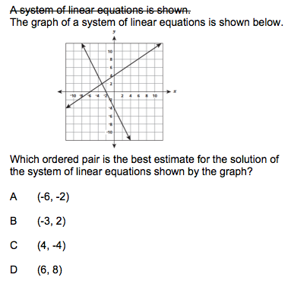
Items use mathematically precise language, are free from mathematical errors or ambiguities, and are aligned to the mathematically appropriate standard.
8.EE.8b. Solve systems of two linear equations in two variables algebraically, and estimate solutions by graphing the equations. Solve simple cases by inspection.
Notes:
Let’s look at this example item written to illustrate Alignment Principle 6.
Answer key: B
What makes this item a good illustration of Alignment Principle 6?
This item shows a fairly common error behind the strikethrough, describing a graph of two lines as a system of equations without actually showing the equations that the lines represent. The text underneath shows a more mathematically precise way to refer to a graph of two intersecting lines. More broadly speaking, there are plenty of misuses of several terms: equation, expression, function, graph, as well as some of the mathematical notation within some of these areas, like correctly referring to a function such as f, its output f(x) for input x, and its graph y=f(x), though these types of errors are more common in high school assessment items when function notation becomes an expectation of the standards.

Slide 20

Alignment Principle #7
The demands of items measuring the Standards for Mathematical Practice are appropriate to the targeted grade level.
Notes:
The Standards for Mathematical Practice should reflect a growing arc of sophistication in assessment items. In early grades, students might give examples or non-examples to show their understanding of a particular claim, but are not asked to prove it or show that it is true for all cases. Similarly, younger students begin modeling real-world situations with equations, but do not engage in the full modeling cycle shown in the high school standards.

Slide 21
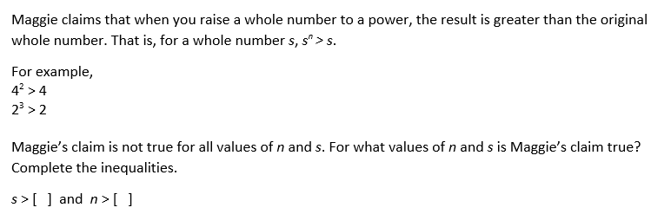
The demands of items measuring the Standards for Mathematical Practice are appropriate to the targeted grade level.
MP3. Construct viable arguments and critique the reasoning of others.
8.EE.A. Work with radicals and integer exponents.
Notes:
© Item adapted from the Smarter Balanced Grade 8 Claim 3 Item Specifications. Available from http://www.smarterbalanced.org/assessments/; accessed April 2016.
Let’s look at this example item written to illustrate Alignment Principle 7.
Answer key: 1; 1
What makes this item a good illustration of Alignment Principle 7?
In the CCSS, there is a part of the text under MP3 that describes an expectation of later grades that students learn to determine domains to which an argument applies. This item is an example of that expectation, asking students to restrict the values of the two variables so that the mathematical claim s^n > s will be true.

Slide 22
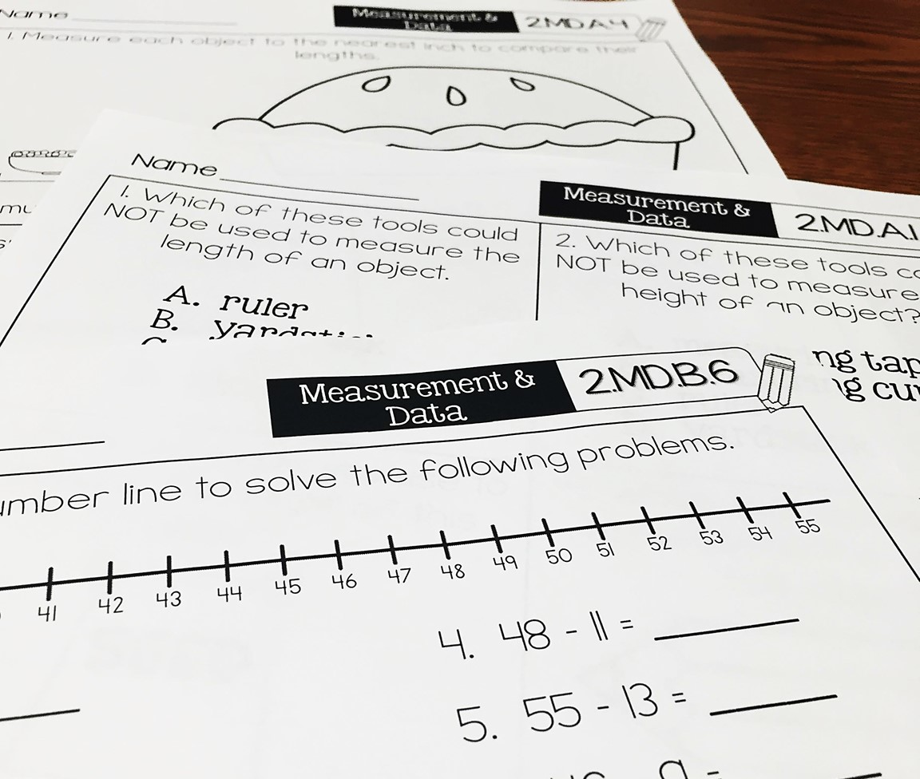
Alignment Principle #8
Item types are chosen to match the item’s purpose and as part of the evidence required by the standards.
Notes:
With many assessments moving online, choices of item type have a lot of driving factors: accessibility, cost, and content. In this section, we will show examples of items that are designed well to meet the evidence required by the standards and are well suited to a particular item’s purpose. This is not to say that a balanced assessment that meets the demands of the standards must include all of these item types nor that this is an exhaustive list of available item types, but that an aligned assessment will include multiple item types. These are illustrations of good ways to collect the evidence required by the standards, but decisions ultimately must be made after carefully considering how to effectively balance cost, content, and accessibility.

Slide 23
Item types are chosen to match the item’s purpose and as part of the evidence required by the standards.
8.EE.B.b. Solve linear equations with rational number coefficients, including equations whose solutions require expanding expressions using the distributive property and collecting like terms.
MP7. Look for and make use of structure.
Notes:
Let’s look at this example item written to illustrate Alignment Principle 8.
Answer key: D
What makes this item a good illustration of Alignment Principle 8?
Regarding item types in general, some assessment developers may have some internally imposed restrictions on the kinds of items available; more creativity is required in the authoring of items to ensure that the evidence being elicited is aligned to the standards being measured. Broadly speaking, multiple choice tends to not be the best choice when trying to determine if students can solve equations in one variable because historically these items have consisted of a list of 4 possible values for x and asked the student to choose the correct one. In grade 6, this is not a problem since substitution is actually the targeted skill, but after grade 6, we don’t want students to continue to use substitution as a primary method for solving equations.
The item shown here provides one way to authentically elicit evidence of students’ ability to solve equations using multiple choice, and is particularly valuable for assessment programs that don’t currently have the technology available for an equation and/or numerical entry capability.
These kinds of items can be strategically designed as this one is so that students can look for and make use of structure or so that students can easily eliminate certain answer choices.. While test taking strategies are often viewed in a negative light, this particular example shows how eliminating answer choices can be quite instructional and require students to think and reason about the meaning of the solution to an equation and its value.

Slide 24
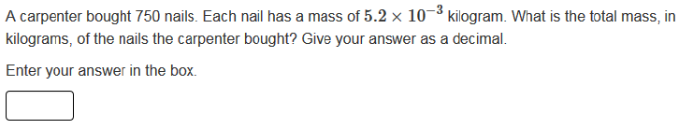
Item types are chosen to match the item’s purpose and as part of the evidence required by the standards.
8.EE.A.4 Perform operations with numbers expressed in scientific notation, including problems where both decimal and scientific notation are used. Use scientific notation and choose units of appropriate size for measurements of very large or very small quantities (e.g., use millimeters per year for seafloor spreading). Interpret scientific notation that has been generated by technology.
Notes:
© Item retrieved from the PARCC Grade 8 EOY Test. Available from https://prc.parcconline.org/assessments/parcc-released-items; accessed April 2016.
Let’s look at this example item written to illustrate Alignment Principle 8.
Answer key: 3.9
What makes this item a good illustration of Alignment Principle 8?
Having equation and/or numerical entry is often ideal when the answer to a question is a number. Students should be diligent in checking their mathematics to a problem and verifying that their answers seem reasonable; with multiple-choice questions students often are alerted that their answers are not reasonable or correct because they don’t show up on the list of options. For classroom teachers, open response has the added benefit of supporting formative assessment, providing better information to look for and summarize student misconceptions or errors. Since summative assessments often serve as a signal to classroom instruction, selecting item types that are best aligned to the desired evidence should be a top priority.

Slide 25
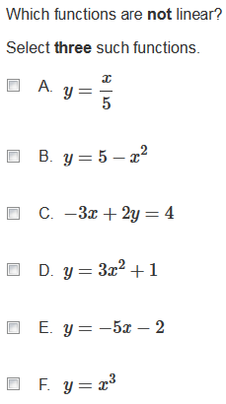
Item types are chosen to match the item’s purpose and as part of the evidence required by the standards.
8.F.A.3. Interpret the equation y = mx + b as defining a linear function, whose graph is a straight line; give examples of functions that are not linear.
Notes:
© Item retrieved from the PARCC Grade 8 EOY Test. Available from https://prc.parcconline.org/assessments/parcc-released-items; accessed April 2016.
Let’s look at this example item written to illustrate Alignment Principle 8.
Answer key: B, D, F
What makes this item a good illustration of Alignment Principle 8?
One of the expectations of standard 8.F.A.3 is that students can sort functions into two buckets: linear and not linear. Selected response items that allow for students to select more than one correct answer work well for standards that require some sort of classification into categories. While drag-and-drop also works well for generating this kind of evidence, the multiple-select item type tends to better adhere to the principles of universal design.
Multi-select items should be used strategically to measure the intent of the standard. Having answer choices that vary widely in their level of difficulty can undermine the use of the item type to collect the evidence required by the standard. Where harder items are needed, assessment programs should develop those separately from those at or below the level of proficiency required by the standard, or use more innovative scoring methods that assign credit for certain combinations of responses.

Slide 26
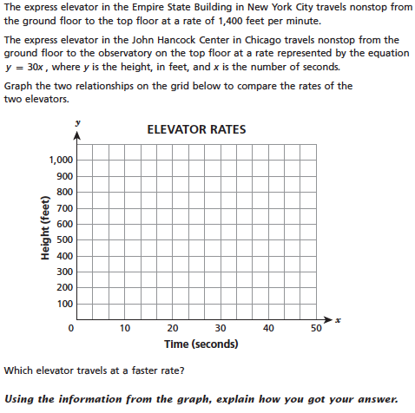
Item types are chosen to match the item’s purpose and as part of the evidence required by the standards.
8.EE.B.5. Graph proportional relationships, interpreting the unit rate as the slope of the graph. Compare two different proportional relationships represented in different ways
Notes:
© Item retrieved from EngageNY.org of the New York State Education Department. 2015 Grade 8 Mathematics Test Released Questions. Internet. Available from https://www.engageny.org/resource/released-2015-3-8-ela-and-mathematics-state-test-questions; accessed April 15, 2016.
Let’s look at this example item written to illustrate Alignment Principle 8.
Answer key: Full credit responses have a correct graph, correct choice for faster rate (Chicago), and a correct explanation
What makes this item a good illustration of Alignment Principle 8?
Standard 8.EE.B.5 opens with the verb “graph.” This is a clear signal that assessments should offer students opportunities to create their own graphs. In grade 8, where students are working primarily with linear functions, most online testing platforms should be sophisticated enough to include item types where students are creating graphs versus selecting them from a list.

Slide 27
Alignment Principle #9
Most items measuring the Standards for Mathematical Practice are also aligned to content standards representing the major work of the grade.
Notes:
Keeping the assessment focused on the major work of the grade is an important design principle in the overall test construction. In measuring the Standards for Mathematical Practice, it is important to help retain the focus of the test by using many items that align to the major work of the grade.

Slide 28
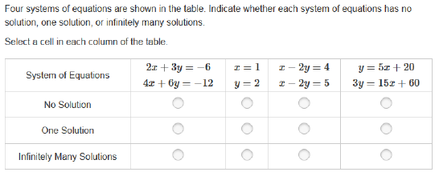
Most items measuring the Standards for Mathematical Practice are also aligned to content standards representing the major work of the grade.
MP.7 Look for and make use of structure.
8.EE.C.8b. Solve systems of two linear equations in two variables algebraically, and estimate solutions by graphing the equations. Solve simple cases by inspection.
Notes:
© Item retrieved from the PARCC Grade 8 EOY Test. Available from https://prc.parcconline.org/assessments/parcc-released-items; accessed April 2016.
Let’s look at this example item written to illustrate Alignment Principle 9.
Answer key:
Infinitely Many Solutions; One Solution; No Solution; Infinitely Many Solutions
What makes this item a good illustration of Alignment Principle 9?
The coefficients chosen in these systems of equations are carefully selected here and the equations written in such a way to reduce the amount of work that students need to do to make a correct selection. Students instead can examine the relationship between the first and second equation in each case and with minimal or no manipulation decide how many solutions the system has.

Slide 29

Alignment Principle #10
Items written at the cluster or domain level measure key integration points not necessarily articulated in individual standards but plausibly implied directly by what is written.
Notes:
A few items per test event may serve as opportunities to connect content across standards, domains, or grade levels. These opportunities should be carefully defined with an established purpose tied back to the language and structure of the standards. An item writer might ask: What key connections are students being asked to make to respond to this question that isn’t articulated in any individual standard?

Slide 30
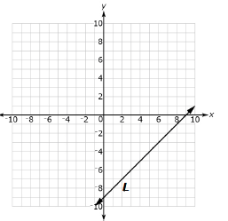
Items written at the cluster or domain level measure key integration points not necessarily articulated in individual standards but plausibly implied directly by what is written.
Line L is shown on the coordinate plane. Use the Add Arrow tool to draw line M such that:
Line L and line M are graphs of a system of linear equations with a solution of (7, -2).
The slope of line M is greater than -1 and less than 0.
The y-intercept of line M is positive.
Primary Alignment: Expressions & Equations Domain
Notes:
© Item adapted from the Smarter Balanced Grade 8 Claim 2 Item Specifications. Available from http://www.smarterbalanced.org/assessments/; accessed April 2016.
Let’s look at this example item written to illustrate Alignment Principle 10.
Answer key: Student constructs a line that meets the given conditions
What makes this item a good illustration of Alignment Principle 10?
The alignment of this item is at the domain level. It requires that students have a solid understanding of the meaning of the solution to a system of linear equations (in cluster 8.EE.C), but also to apply their understanding of slope and y-intercept to construct the correct line (knowledge and skills articulated in the standards for cluster 8.EE.B). Items at the domain level provide more comprehensive evidence of students’ understanding of the bigger picture of mathematics, and items written at this level help demonstrate to students and teachers that the standards are not a checklist of things to complete, but contain important concepts and skills that must be explicitly integrated.

Slide 31
Ten Principles of CCSS-Aligned Items
1. Most items aligned to standards in supporting clusters connect to the major work of the grade.
2. Items are designed to address the aspect(s) of rigor (conceptual understanding, procedural skill, and application) evident in the language of the content standards.
3. Items are designed to attend to content limits articulated in the standards.
4. Most items aligned to a single content standard should assess the central concern of the standard.
5. Representations are well suited to the mathematics that students are learning and serve an important purpose within the item itself.
6. Items use mathematically precise language, are free from mathematical errors or ambiguities, and are aligned to the mathematically appropriate standard.
7. The demands of items measuring the Standards for Mathematical Practice are appropriate to the targeted grade level.
8. Item types are chosen to match the item’s purpose and as part of the evidence required by the standards.
9. Most items measuring the Standards for Mathematical Practice are also aligned to content standards representing the major work of the grade.
10. Items written at the cluster or domain level measure key integration points not necessarily articulated in individual standards but plausibly implied directly by what is written.
Notes:
The principles illustrated throughout this module are intended to support those charged with developing summative mathematics assessment items and to support training efforts for those who review the content of items.

Slide 32
Thank You!

